Slide 1
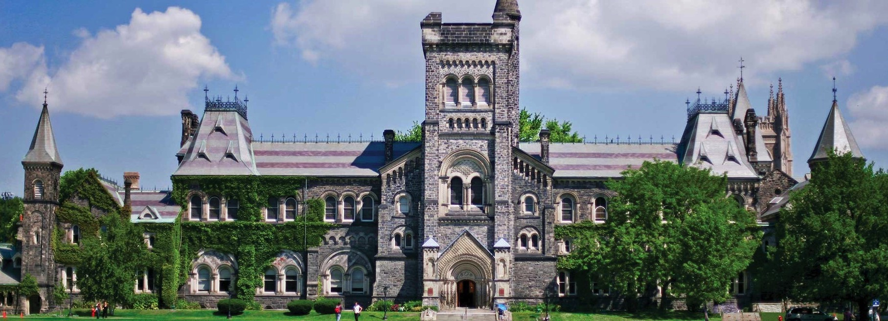

SAP S/4HANA Migration
Connect & Learn
Philip Millenaar – SAP Modernization Program Manager
Lorena Gaudio – Financial Services Project Lead
Chris Dimitriadis – FAST Team Manager
October 2020

Slide 2
Session Objective
1
SAP Modernization Program
Background & Current Phase 3
2
Phase 3 – S/4HANA what to expect
3
Training and Support
Notes:
Phil

Slide 3


Program Background
Support of the existing SAP platform on which the University of Toronto systems are built will cease by 2025
In 2018 the University signed a new contract with SAP to upgrade/modernize these systems …
Kronos
JDXpert
True Blue
Cority
Taleo
Halogen
uSource
SAP Administrative Management Systems
Student System
ROSI
1998
2018 Java
Finance System
1995
HRIS
1998
Research
Administration
1996
Student
Accounts
2017
1995
Funds Management:
Research &
Donations
high
volume
Approximately 5,000 customized programs, 2,500 tables, 140+ Interfaces
51 instances, Production DB: 697 GB
Notes:
Phil

Slide 4



Program Workstreams
Expand and/or replace all Talent Management products at the University of Toronto including:
  Staff Learning Management Module (new)
  Performance and Goals (replaces Halogen)
  Recruiting (replaces Taleo)
  Onboarding (new)
  Succession Planning (new)
  Employee Central (replaces components of HRIS – employee profile and org structure)
SuccessFactors
Migration of the U of T Finance System to SAP S/4HANA Finance
  Migrate to the Business Partner
  Upgrade entire Finance System to the HANA database
  Code clean up
  Optimize some business processes and enable new technology (e.g. Fiori, Embedded Analytics)
S/4HANA Finance Upgrade
Upgrade all systems at U of T including HRIS Core and the Research Information System to the new HANA database to allow for
  improved system performance
  access to the new web interface design tools to allow for a better user experience
HANA Database Upgrade
Migrate all systems at U of T from the University data center to the Azure data center on Front Street to allow for:
  improved system performance, reliability and security
  24/7 monitoring
AMS Cloud Migration
Notes:
Phil

Slide 5
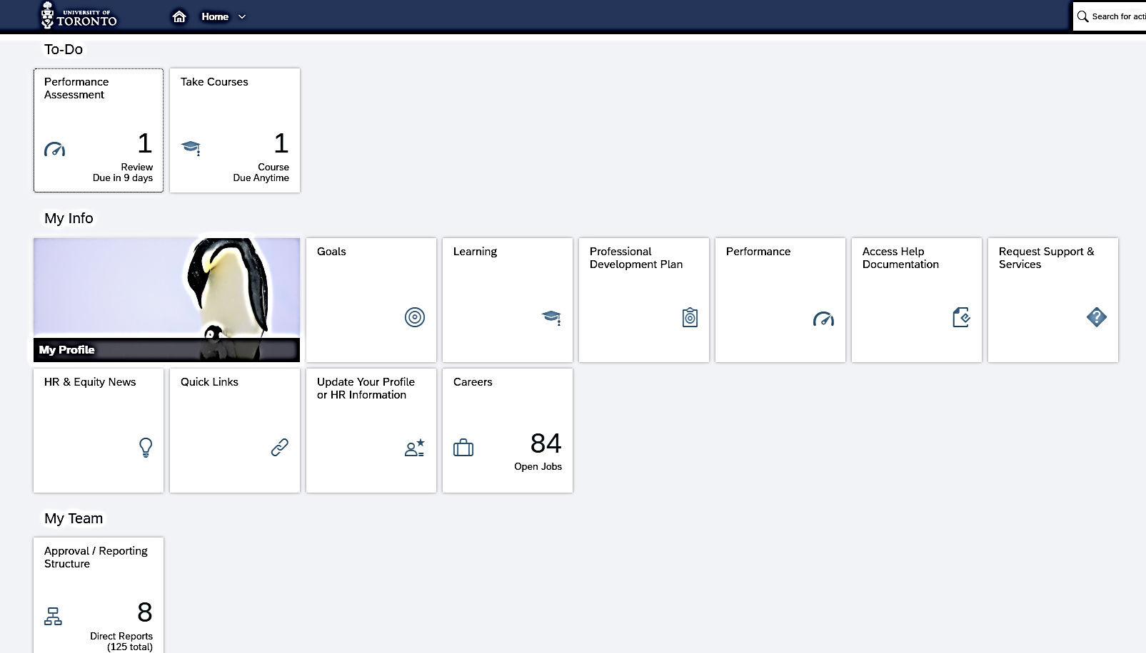
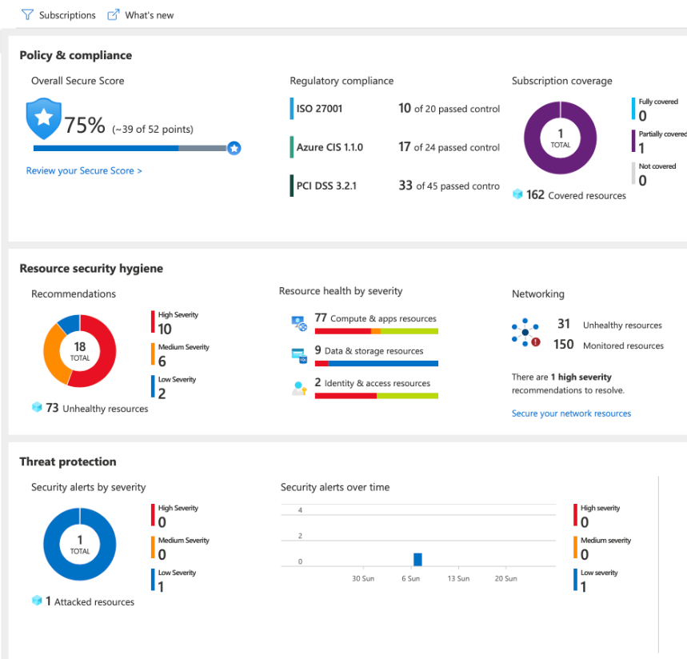
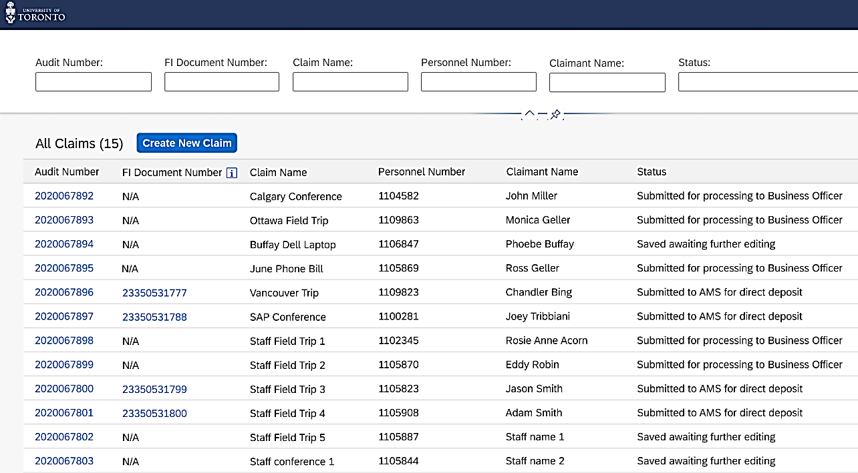
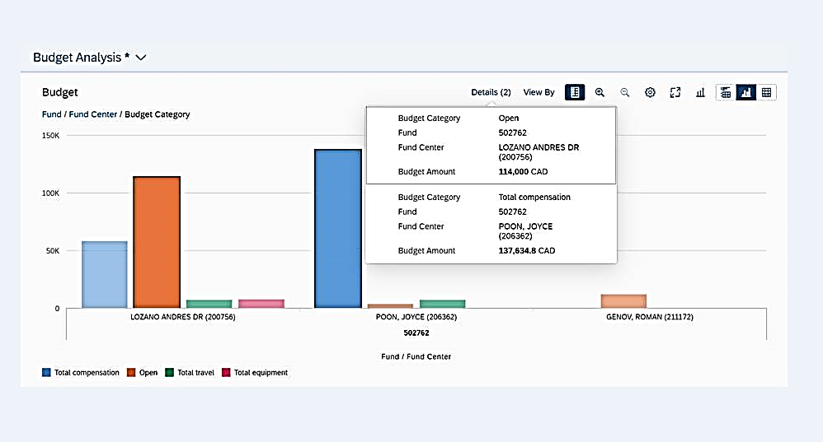
Improved User Experience
Security, Disaster Recovery, Performance
Human Resources
Finance – Future – ERDD on the Web
Research
Notes:
Phil

Slide 6

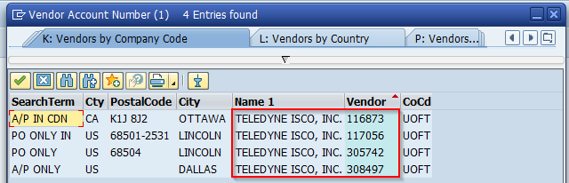
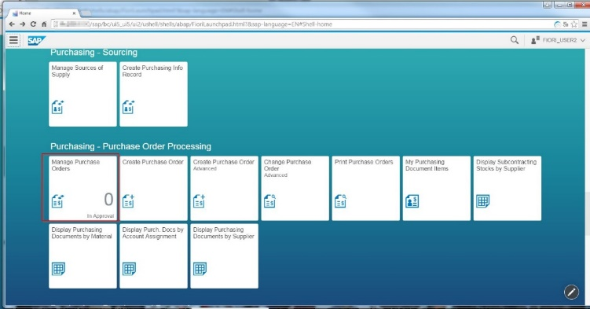
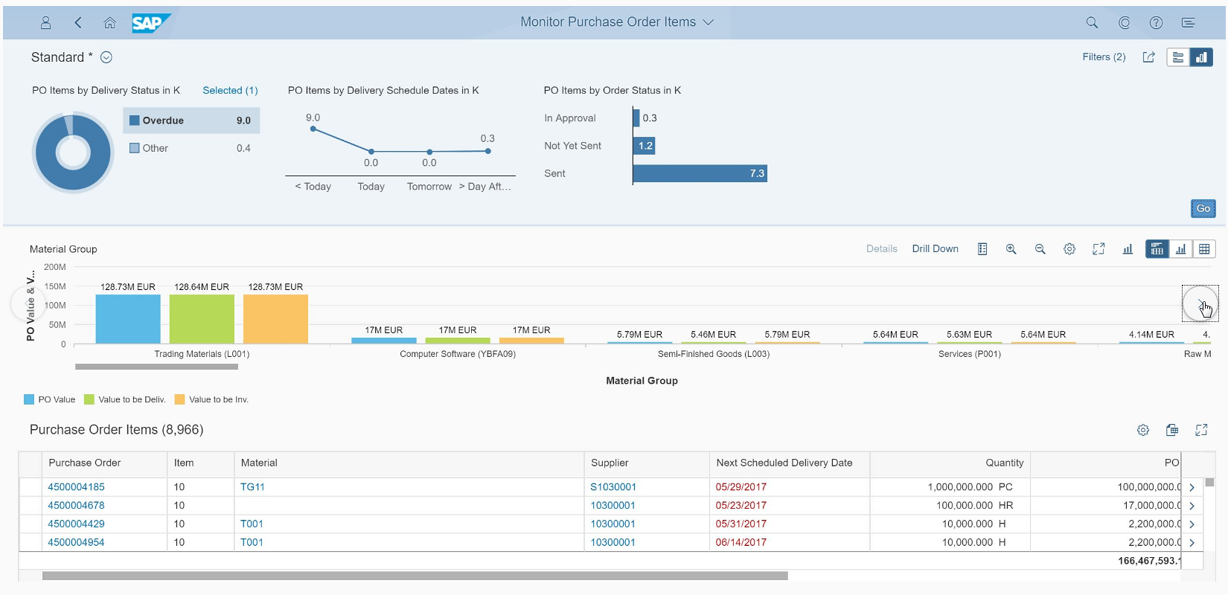
Vision for Finance – Evolve Systems Over Time
Performance
In-memory database design (i.e. HANA)
Optimization
Resolve existing FIS Pain Points (e.g. Vendor Account Management, Account Reconciliation, Reporting)
Work Stream #1 – November 2020
Technical Migration to S/4HANA
User Experience
Fiori Applications (e.g. ERDD and others)
Insights
Embedded Analytics
Work Stream #2 – November 2020 and beyond
Leverage modern SAP technology for value to the University
6
Notes:
Phil

Slide 7
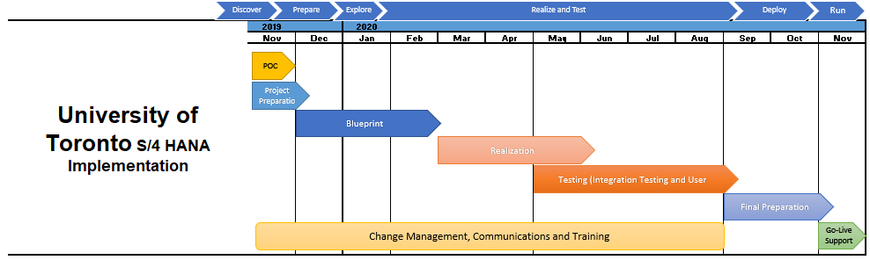
Project Timeline
Today
AMS S/4HANA will be released to end users at 7am on Tuesday, November 3, 2020
Notes:
Phil

Slide 8
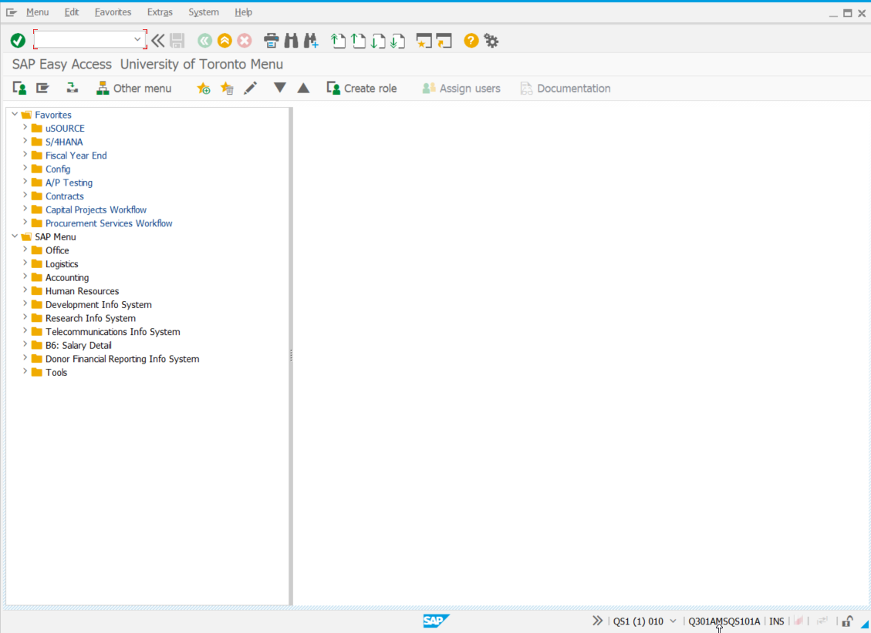
Major Changes
1
New SAP GUI Theme
Enjoy Theme is no longer available
Blue Crystal is recommended/default
The differences between the Enjoy Theme and the Blue Crystal theme are primarily cosmetic. A quick comparison is available at the link below:
https://easi.its.utoronto.ca/wp-content/uploads/2020/10/Changes-From-New-SAP-GUI-Deployment.pdf
Notes:
Chris D.

Slide 9
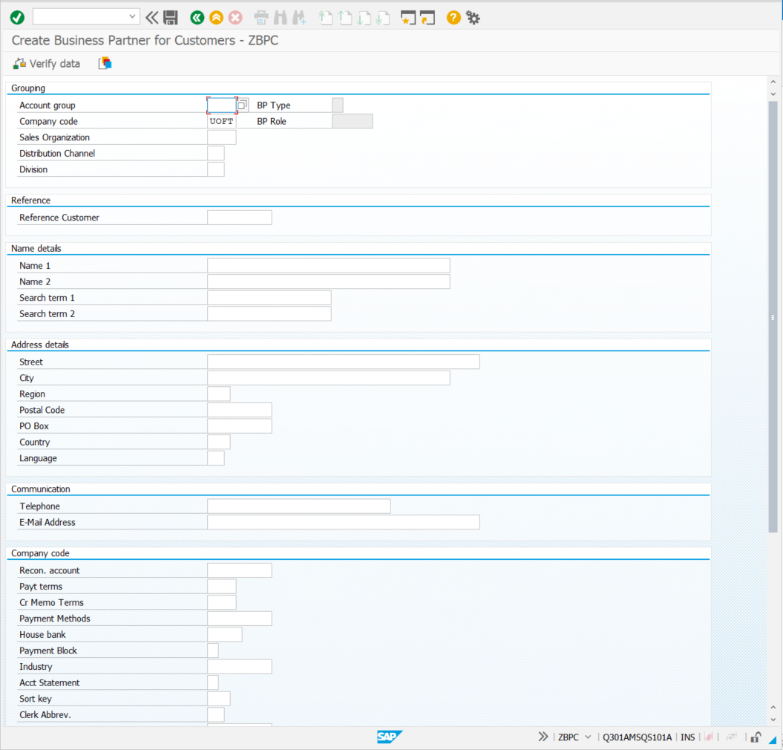

Major Changes
2
SAP Business Partner
Limited impact: end users who create
or change customers and/or vendors will use the new Business Partner function
There is no change when processing transactions. Users will continue to use Vendor and Customer accounts as they do now.
If displaying a Vendor or Customer master record, the information will now be viewed through the Business Partner display transaction
Notes:
Chris D.

Slide 10

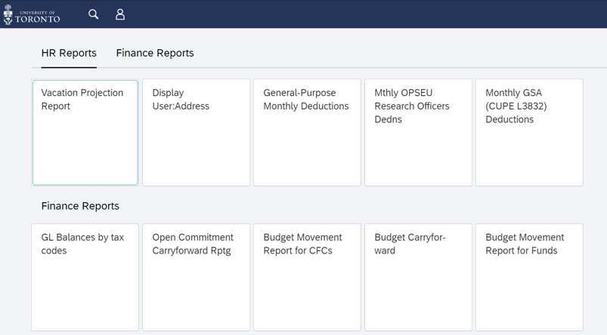
Major Changes
3
Elimination of the RPT Clone
RPT Clone resulted from AMS historical performance shortcomings
Evolved into other use cases
New solution will:
Be web-based
Use login via UTORid
Provide AMS reports that see heavy usage during AMS lockout periods (e.g. payroll, fiscal ME, fiscal YE, Holiday break)
Have a more modern “Belize” theme
Notes:
Phil

Slide 11

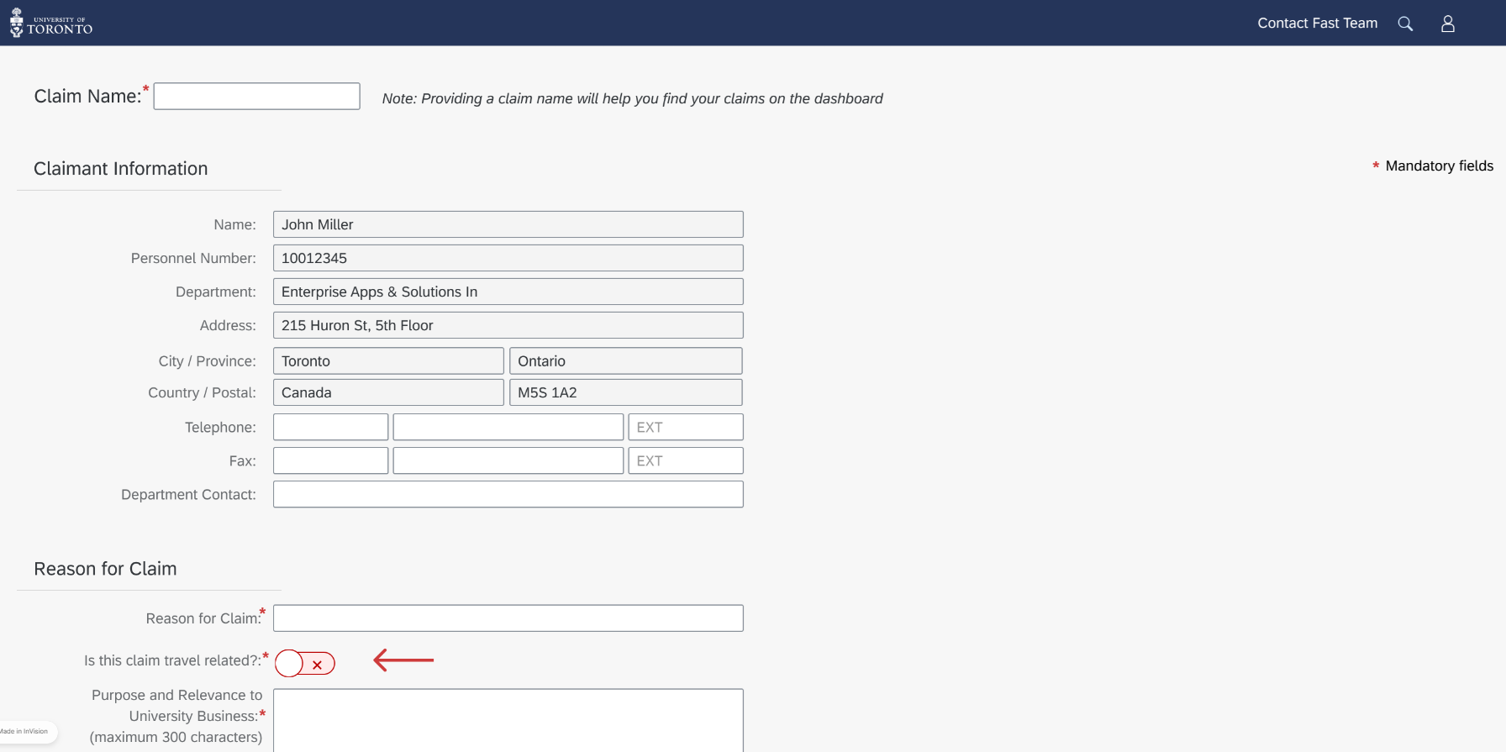
Major Changes
4
Improvements to ERDD on the Web (2021)
Modernized user experience
Latest SAP web technologies
Responsive to your screen/device
Notes:
Phil

Slide 12
Training and Support
FAST-hosted online S/4HANA information sessions (more details coming soon):
  October 27th
  October 29th
  November 4th
A dedicated S/4HANA page will be established on the Financial Services Department website (https://finance.utoronto.ca/), cons all supporting documentation and information.
All impacted FAST Team reference guides, simulations and Knowledge Center articles will be updated to reflect S/4HANA changes.
On-going support will be available through your FAST Team Faculty Representatives, and the general FAST.HELP@utoronto.ca mailbox
Notes:
Phil

Slide 13


SAP Modernization Program
2021
2020
Research
MRA
Finance
Succession
Planning
RFP
Employee
Central
Finance
UX
2019
Recruitment
S/4HANA
Finance
SuccessFactors
LMS/P&G
Transfer
H/W to Azure
Notes:
Phil

Slide 14

Q&A
DELOITTE + UNIVERSITY OF TORONTO

