Slide 2
CONNECT+LEARN Introducing the New Whiteboard
Today’s session will discuss:
Accessing the new Whiteboard
A new look and feel for Whiteboard
New Whiteboard features overview
What’s next for Whiteboard?
Considerations
Activity

Slide 3
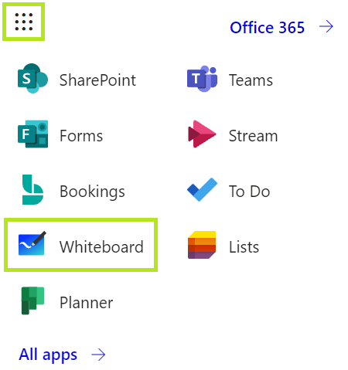
CONNECT+LEARN Accessing Whiteboard
Whiteboard for the web
Go to mail.utoronto.ca
Click on the ‘waffle’ in the top left menu
Click on Whiteboard (if you don’t see it, click All apps)
Whiteboard for Teams meetings
Launch your Teams meeting
Click on the screen sharing icon
Go to the far right of the menu that launches and click Whiteboard

Slide 4
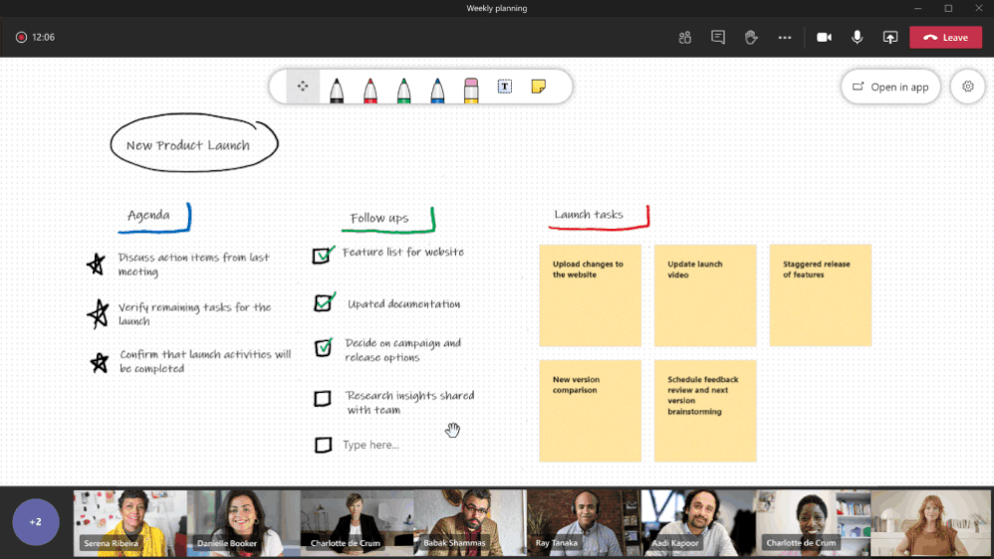

Slide 5
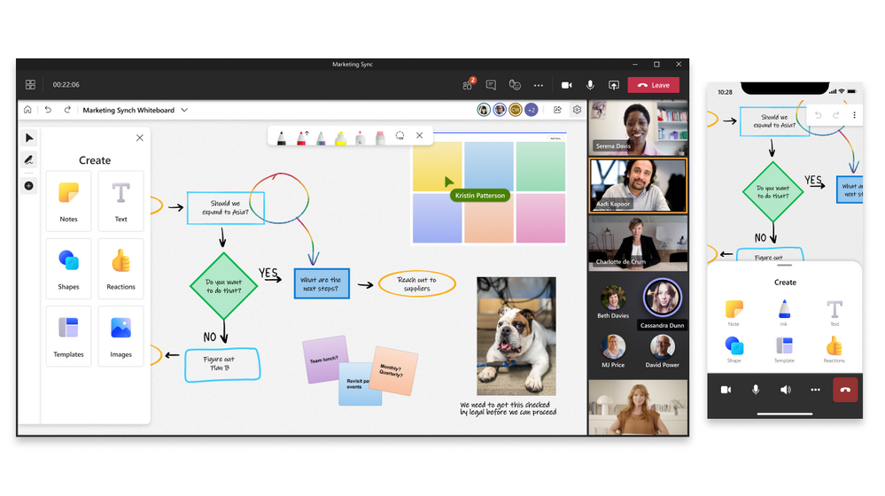

Slide 6
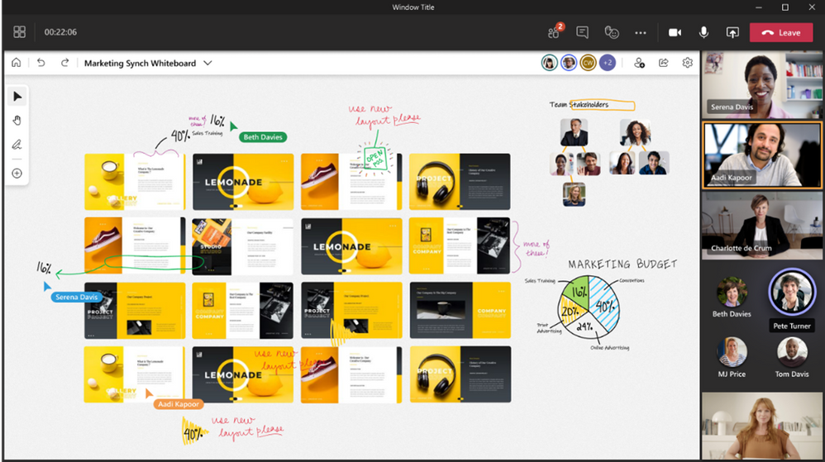
CONNECT+LEARN Key features coming soon
Updates to the desktop version of Whiteboard
The ability to import documents such as PowerPoint slides into Whiteboard
Improved attribution
A laser pointer
The ability to lock content
And more…

Slide 7
CONNECT+LEARN Important considerations
Until the desktop version of Whiteboard is updated, you cannot use new features from the web version (e.g. templates) with the desktop version of Whiteboard.
External attendees cannot currently access the Whiteboard during Teams meetings. Microsoft is releasing an update in October that will address this.

Slide 8
CONNECT+LEARN Resources
Summary of new Whiteboard changes from Microsoft: https://techcommunity.microsoft.com/t5/microsoft-365-blog/welcome-to-the-new-whiteboard/ba-p/2779824
A guide to the new Whiteboard: https://support.microsoft.com/en-us/office/microsoft-whiteboard-help-d236aef8-fcdf-4b5e-b5d7-7f157461e920

Slide 9
Questions
Go to uoft.me/connectandlearn for more information and to subscribe to the newsletter.

