Slide 1
ADO Connect and Learn
November 21-22, 2023
Frank Boshoff

Slide 2
Framing and Background
Intended for independent users who will not be working in the UofT-ITS instance of ADO
Deadlines – December 13, 2023 for offboarding from Jira Server, January 31, 2024 - end of U of T's license, February 15, 2024 – end of life
Recommendation is to move to ADO and not the free version of Jira Cloud -> Jira Software Cloud Standard as the minimum due to security requirements
Integrations w ESC and SharePoint are a work-in-progress
Update for Confluence - EASI will be migrating all content and users from Confluence Server to Confluence Cloud. Further communications will follow in early 2024.

Slide 3
Overview of the JIRA Migration Project
The focus of this session is Azure DevOps (ADO)
High-level overview
Who does what
Billing and license costs
Where to gain more knowledge

Slide 4
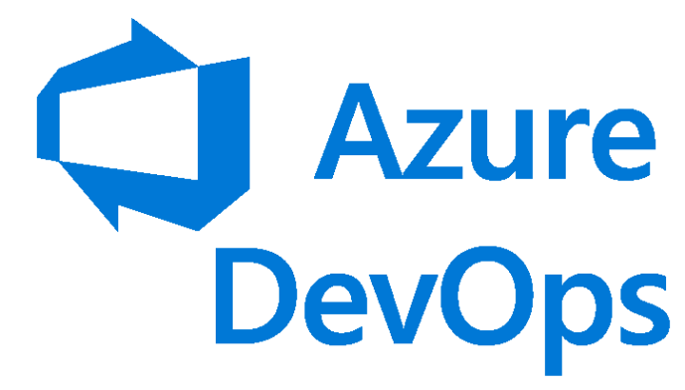
Migration

Slide 5
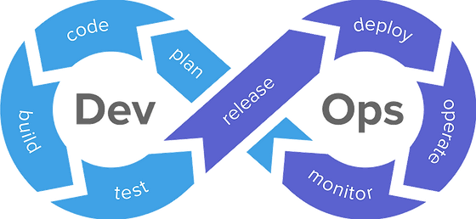
Azure DevOps
Software as a service (SaaS) Platform from Microsoft
Platform to implement Dev-Ops Processes

Slide 6
Azure DevOps
Repos
Boards
Artifacts
Pipelines
Test Plans

Slide 7
Benefits of ADO
Improved visibility into work effort, workload management, and expectation management
Aligns with U of T’s technical roadmap and future evolution with Microsoft
Improved operational reporting and insights for strategic decision making.

Slide 8
Why is ADO recommended
Falls under the University's Enterprise Agreement with Microsoft
Simple procurement process
Not a free service...which provides the University with some rights

Slide 9
Divisions with an Azure subscription
Divisions that have an Azure subscription are able to establish an Azure DevOps instance in their subscription.
Costs will be included in the subscription billing
No dependency on ITS to create the ADO Org
No support needed from ITS (ITS will not have access to the ADO Org)
ITS can share knowledge and learning

Slide 10
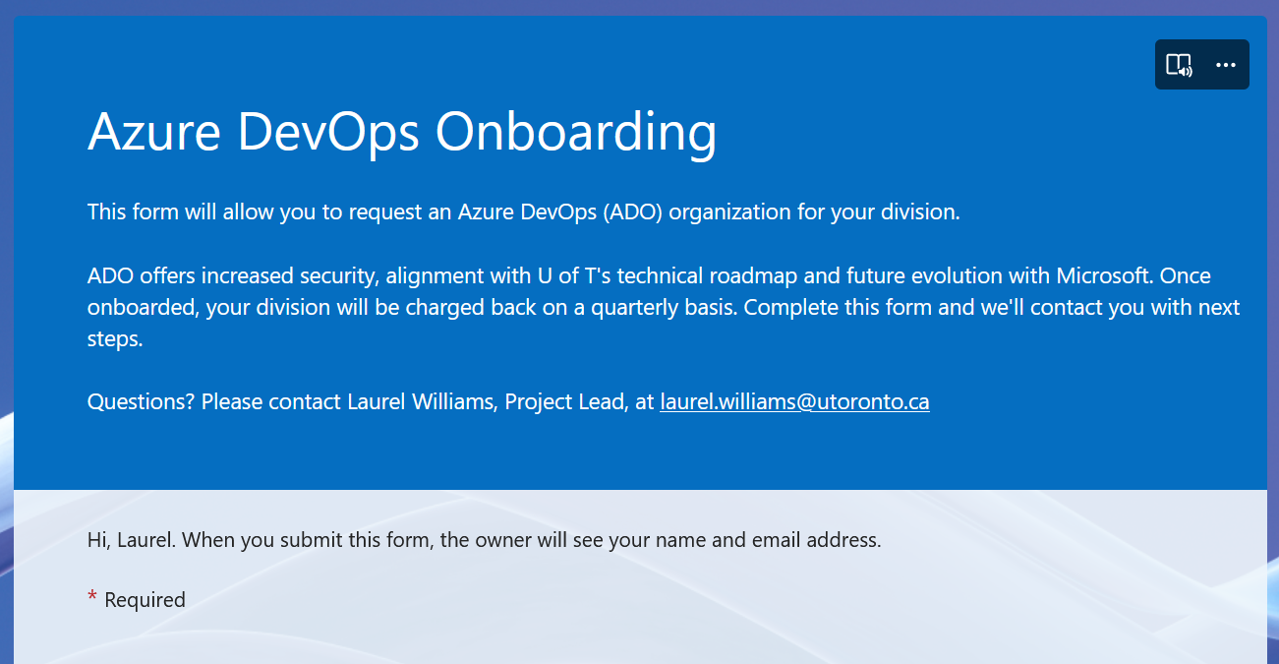
Divisions without an ADO subscription
Click here to open the form

Slide 11
Responsibilities
ITS will create the Org
Set up the Org Admin, charge back billing and handover the administration
Divisions will manage their own ADO Org
The Org Admin will add divisional users and assign permissions
The Org Admin will create the initial project teams/backlogs
The Org Admin is responsible for managing the assignment of licenses and the associated costs

Slide 12
Billing
ITS Business Operations and Administration will apply funds transfers for the Microsoft charges on a quarterly basis
Each ADO Org/Division is billed individually for the number and type of licenses it consumes
The divisional CAO, or delegate, approves a Fund Transfer to ITS

Slide 13
ADO License Types and Costs
Four license types:
Stakeholder – free, with some limited functionality, but fine for people who are not part of the delivery team, e.g., managers, users
Basic – CAD$8/user/month, full functionality except for Test Plans (see below) and suitable for developers, project managers, team leads
Basic + Test Plans – CAD$76/user/month, needed for comprehensive testing initiatives that require test cases, test results, and test metrics
Visual Studio Enterprise license – CAD$550/year/developer, provides a personal Azure subscription for experimentation and investigation with a budget limit of CAD$200/month, which is included in the cost of the license

Slide 14
Resources
Microsoft Documentation on Project Management using Azure Boards is excellent
Microsoft Training and Learning Paths (e.g. https://learn.microsoft.com/en-us/training/browse/?terms=DevOps&source=learn&resource_type=learning%20path)
ITS can share knowledge and learning

